Slide 1
NEW TOPIC
Algebra

Slide 2
Contents
Glossary or Formula Page
Page
Date
Description
Word
Description
2
3

Slide 3
Tasks
24
7
30
Topic
Essential Question
Questions
Notes
Summary
8
9

Slide 4


Warm Up
Each of these squares is made of matchsticks.
Draw the image on your page
Count the number of smaller squares and number of matchsticks in each image
Draw what you think the next image would look like
    How many smaller squares are in it?
    How many matchsticks are in it?
Extension: Try the same thing with this image

Slide 5
24
7
30
Algebra
Date
EQ – How to find a rule from a number pattern?
Using rules
Math can be used to describe relationships in the word around us.
Sequence
Term
Rule
A number pattern can be called a sequence
Each number in the sequence is called a term
A sequence has a rule that describes the pattern
0, 1, 1, 2, 3, 5, 8, 13, 21, 34
There are some famous rules! Anyone know the name of this one?

Slide 6
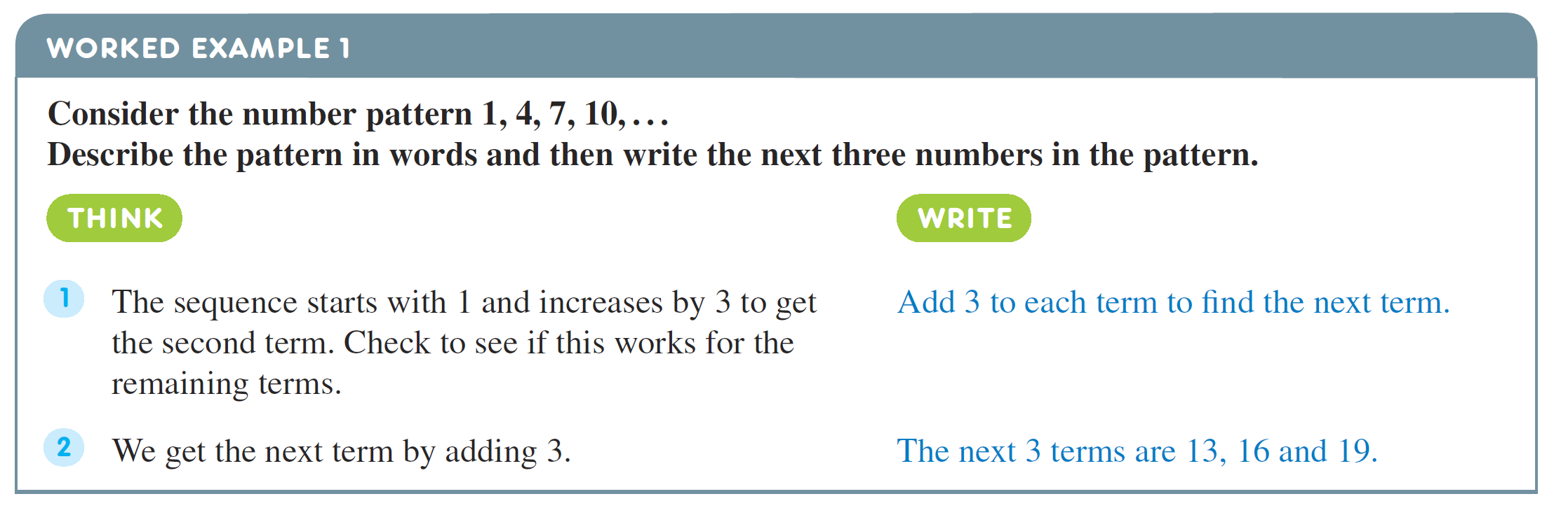
24
7
30
Algebra
Date
EQ – How to find a rule from a number pattern?

Slide 7
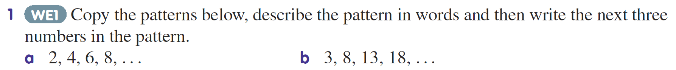
Practice

Slide 8


Slide 9
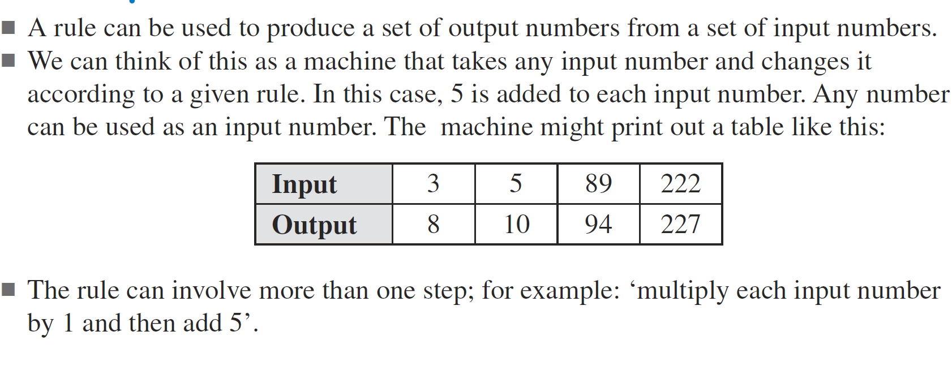
24
7
30
Algebra
Date
EQ – How to find a rule from a number pattern?
Input and Output Tables

Slide 10
24
7
30
Algebra
Date
EQ – How to find a rule from a number pattern?
Finding a rule
Steps
Picture
Table
Rule
Determine from the picture what you will be counting (smaller triangles or matchsticks in this case)
Fill out your input output table
What is the relationship between the numbers?
Can you use this to guess the next image?
Building a table
Input (image number) | 1 | 2 | 3 | 4
Output (number of triangles) | 1 | 4 | 9
THINK PAIR SHARE
Can you find a relationship between the input numbers and output numbers?
16
Rule
Each input number is multiplied by itself (squared) to get to the output number

Slide 11
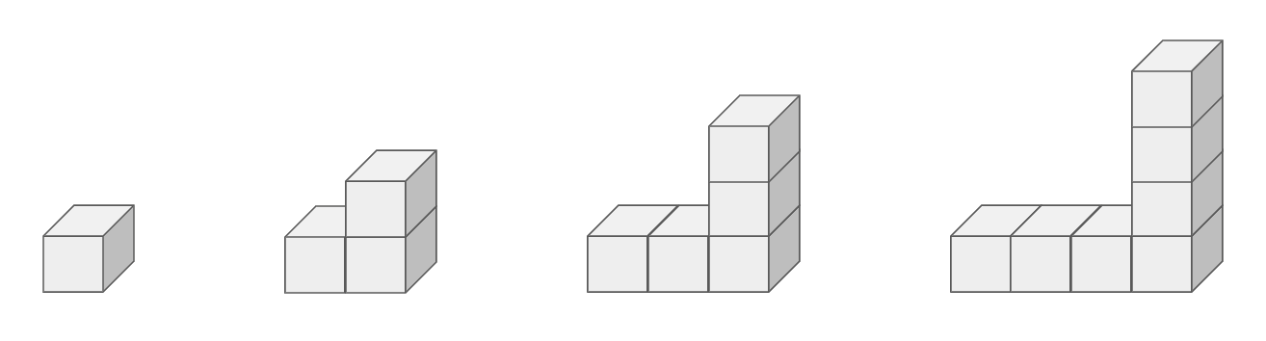
Picture
Table
Input (image number) | 1 | 2 | 3 | 4
Output (number of cubes)
Rule
The input number is ______________ by _______ then _______________ to get to the output number.
Notes:
Multiply by 2 subtract 1

Slide 12

Picture
Table
Input (image number) | 1 | 2 | 3 | 4
Output (number of footballs)
Rule

Slide 13
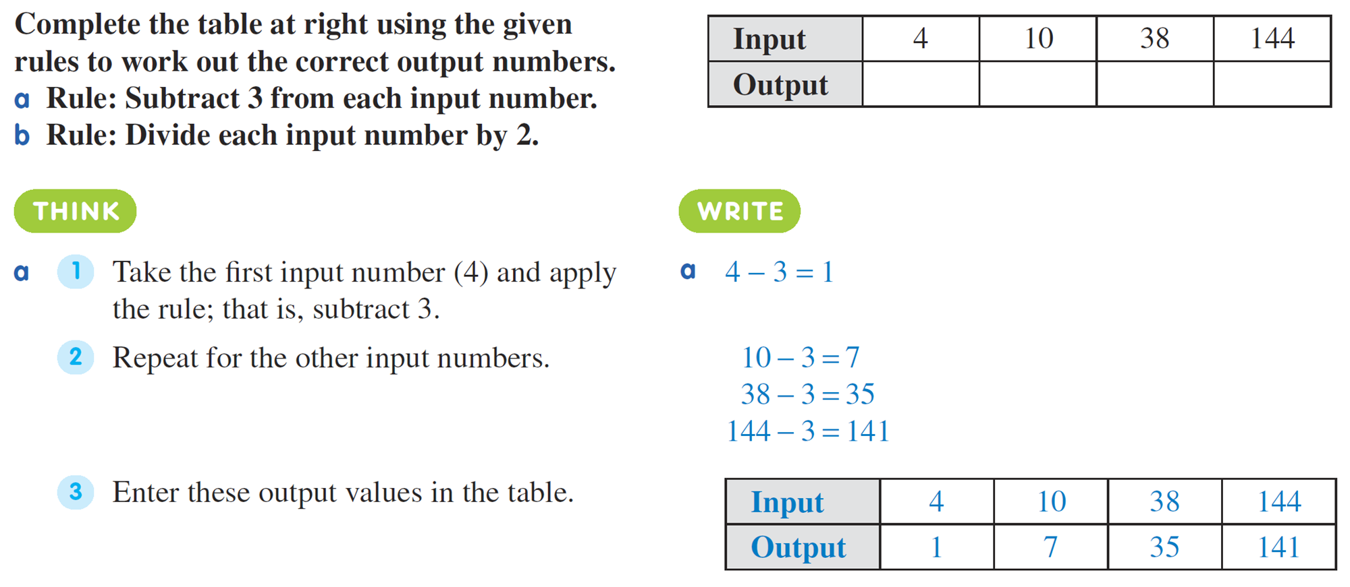
24
7
30
Algebra
Date
EQ – How to find a rule from a number pattern?

Slide 14
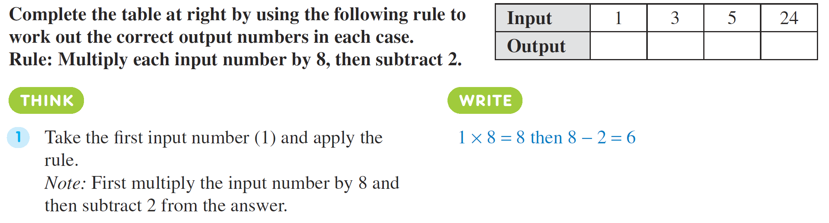
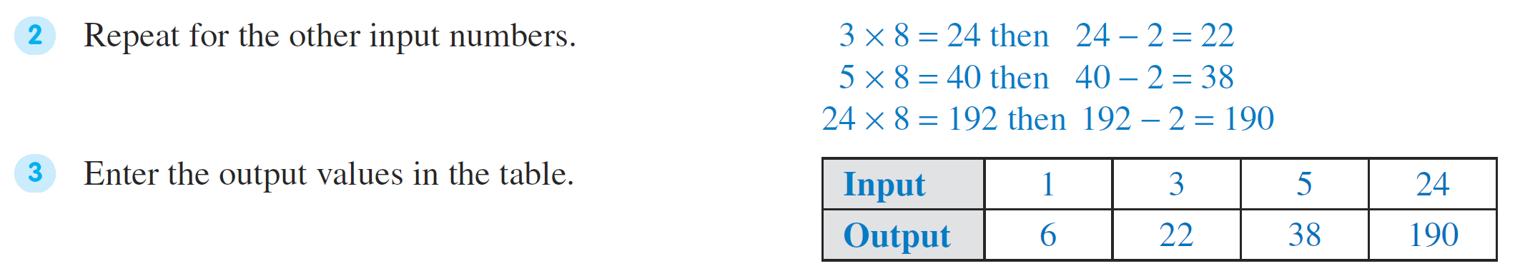

Slide 15

Pattern Sleuthing WS
Notes:
Pattern sleuthing WS is page 6 on the “unit Patterns teacher resource” PDF on connect

Slide 16
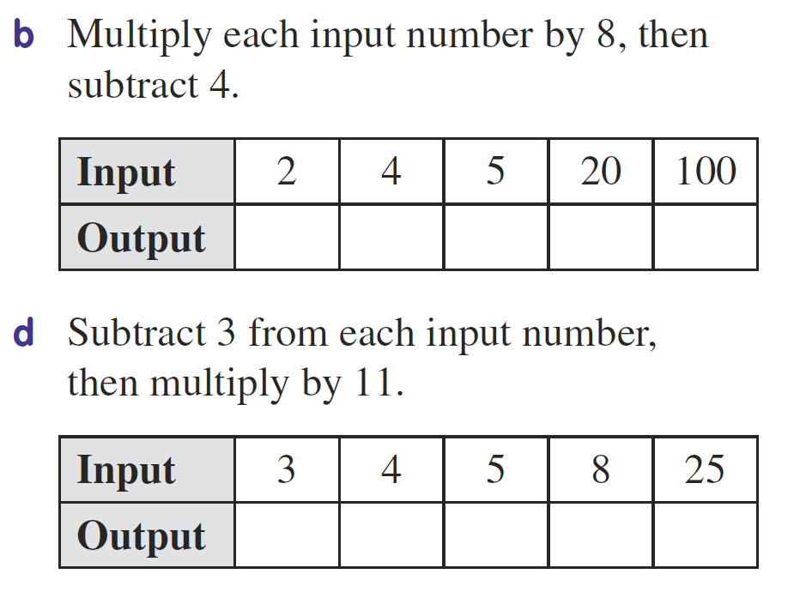
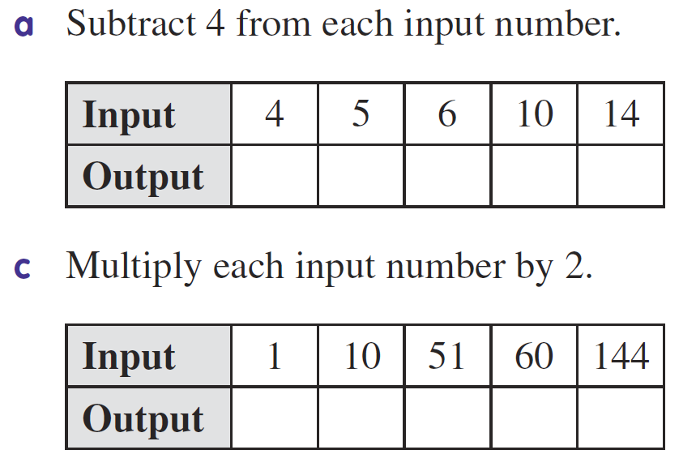
Task
Complete Summary and Exit Pass once done

